Slide 1

The History Behind Software Bugs
Nihal Alfred

Slide 2
What is a bug?
A bug in programming is described as:
“An error, flaw or fault in a computer program or system that causes it to produce an incorrect or unexpected result, or to behave in unintended ways — Wikipedia.”
A bug can be
“anything from an infinite loop to a division by zero to using an uninitialised variable!”
These examples go to show how just a simple overlook could mean unwanted behaviours in your code.

Slide 3
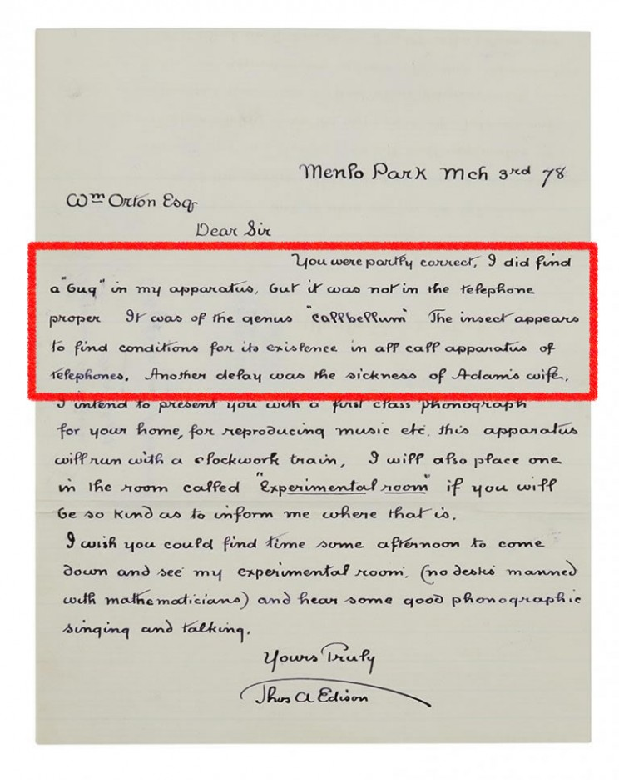
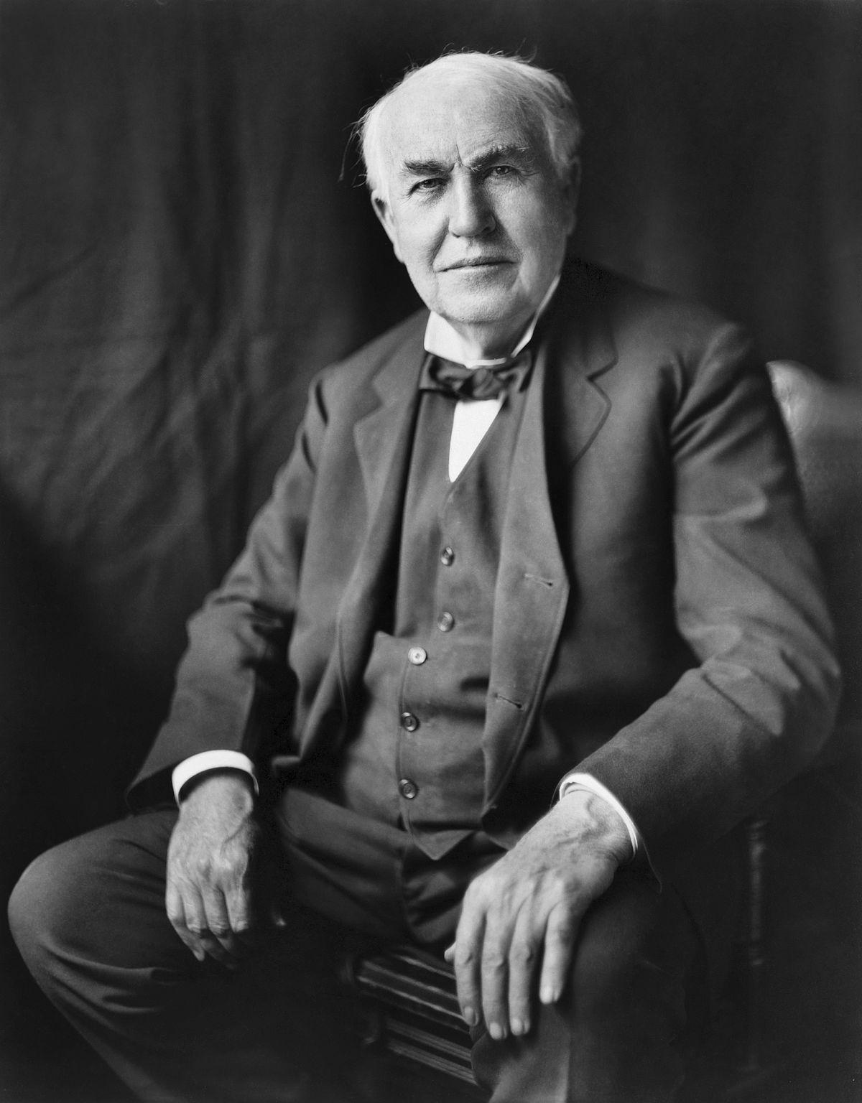
Mechanical Malfunctions
1870 > Thomas Edison
Mechanical malfunctions in hardware engineering

Slide 4




Slide 5
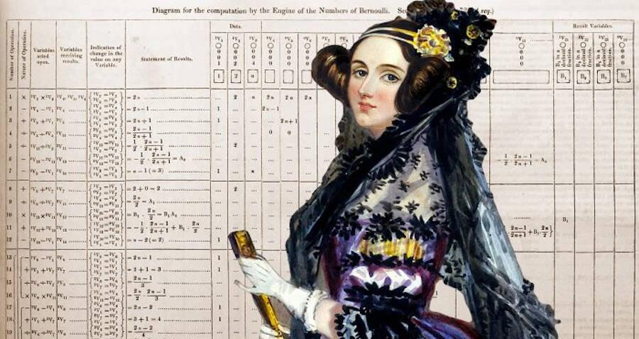
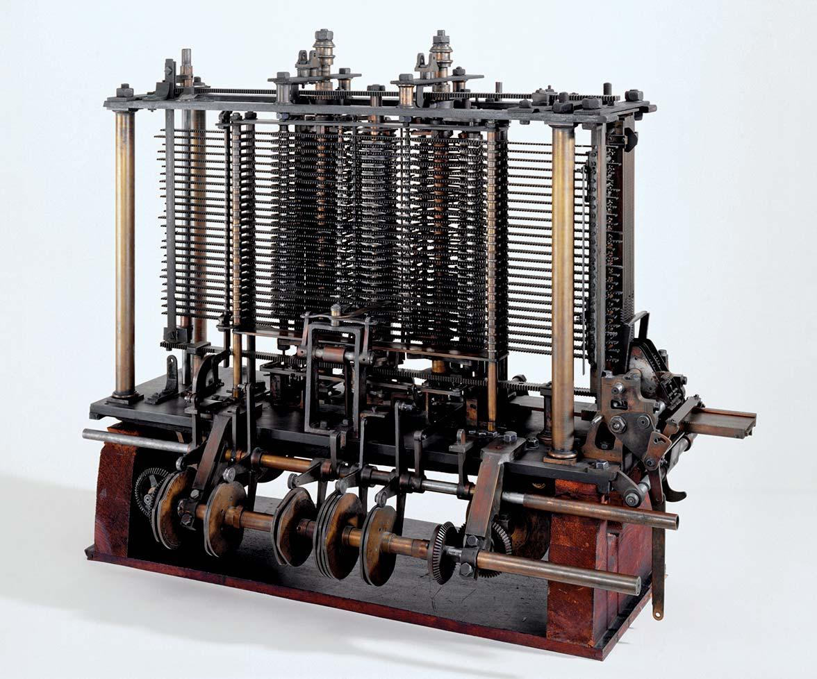
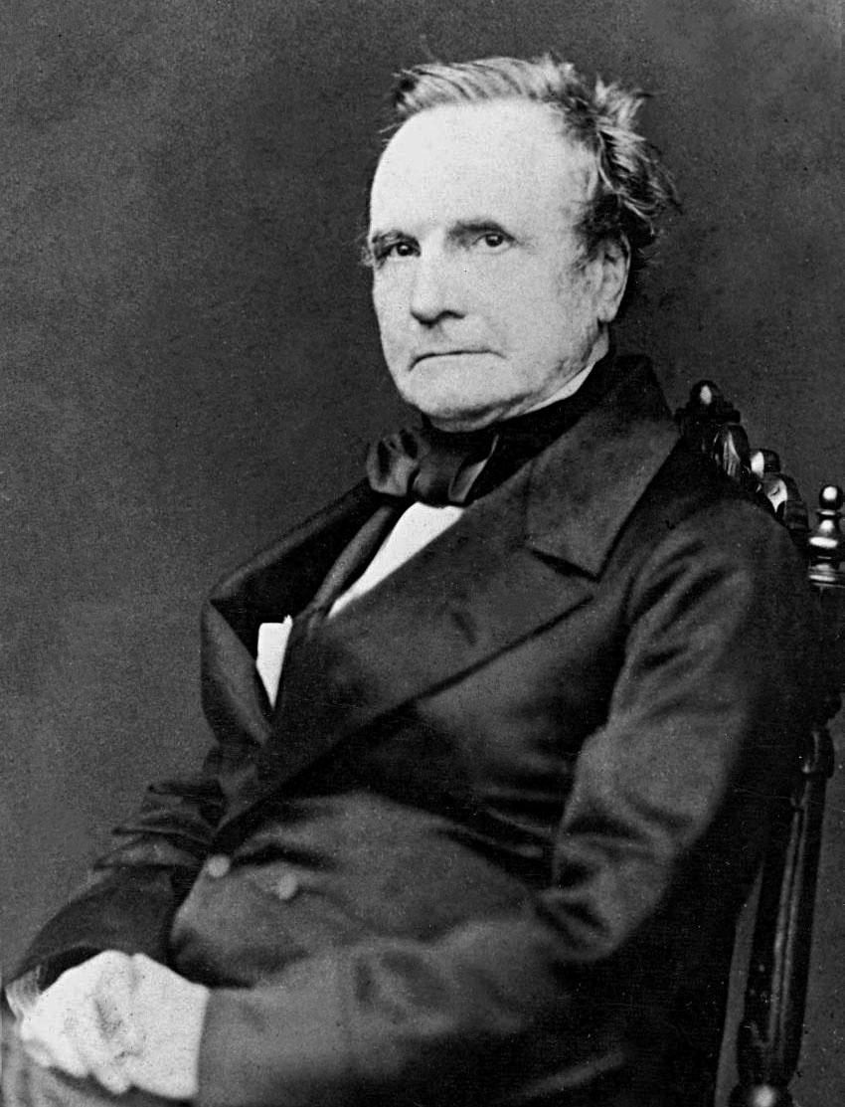

Slide 6

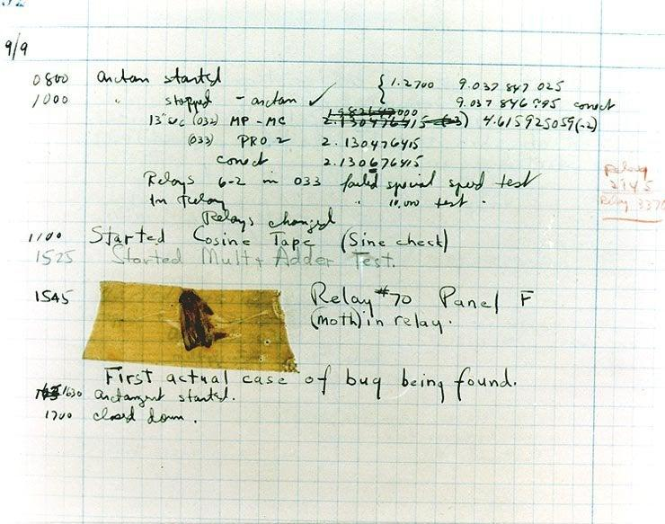

Actual bug

Slide 7
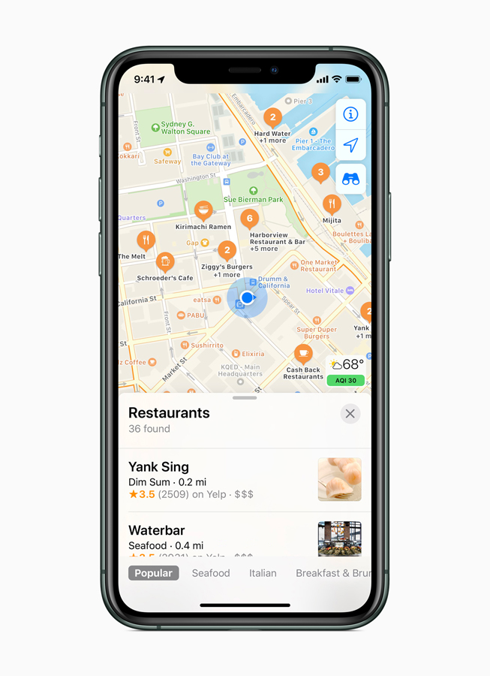


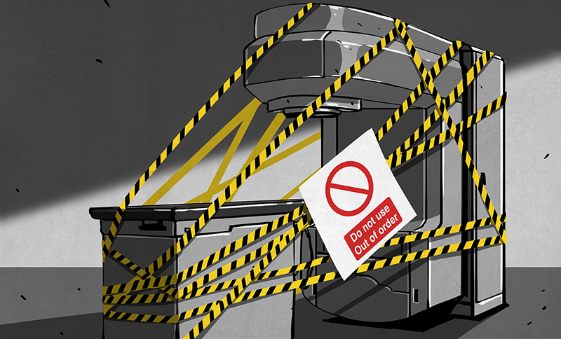
From Insects to disasters

